Slide 1

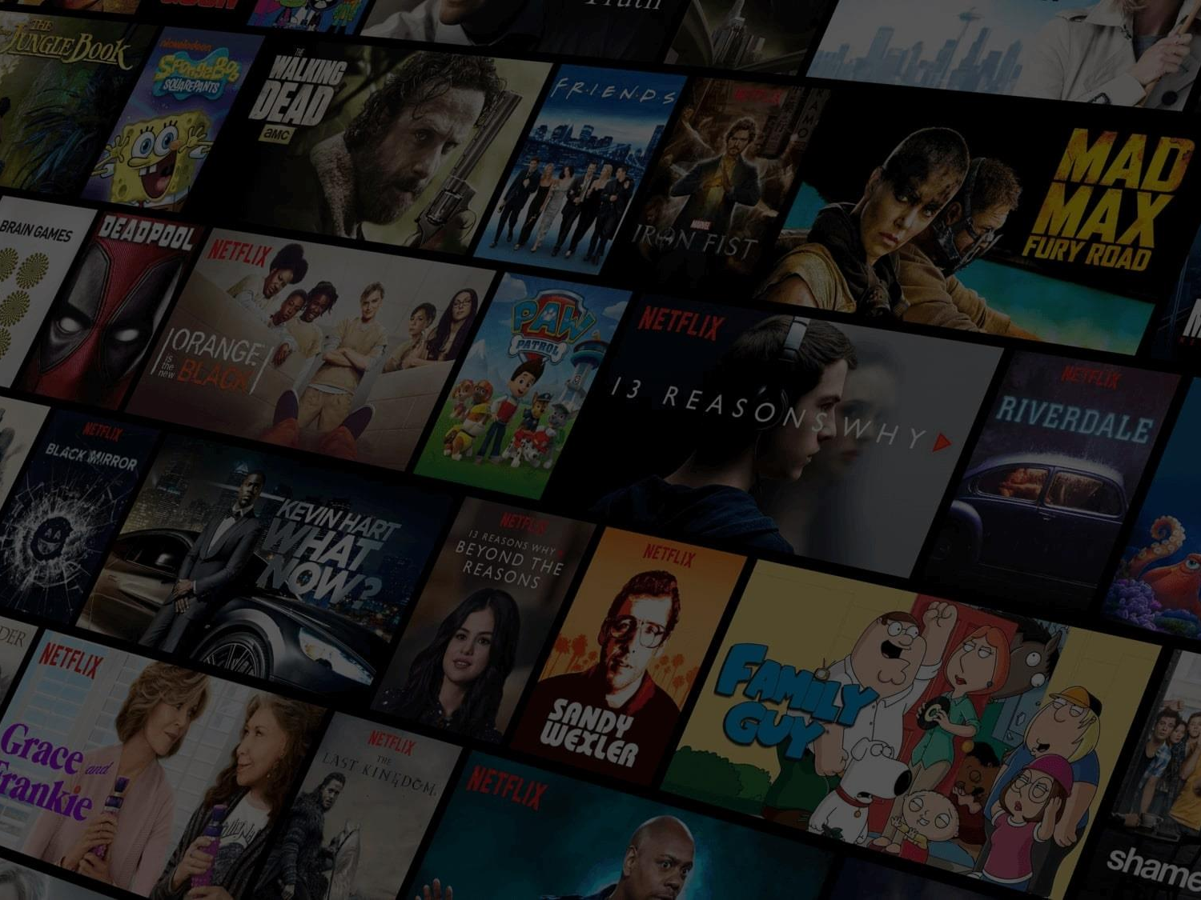
What is a Recommendation System ?
As it is clear by name, Recommender System is a piece of software that recommends us the relevant products or services.
Some real life examples of recommender system:
Amazon recommends us products based on the products we checked out in the past.
Netflix recommends us movies based on our watch history.
Google gives us suggestions when we type something in the search box based on our search history.

Slide 2
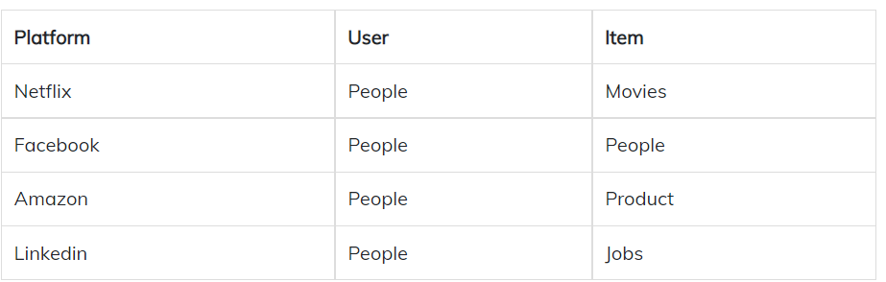
Components of any Recommendation System
There are basically two main components of any recommendation system, Users and Items. Items are the entities that are recommended by the recommender system to the users. Let’s understand by taking some examples

Slide 3
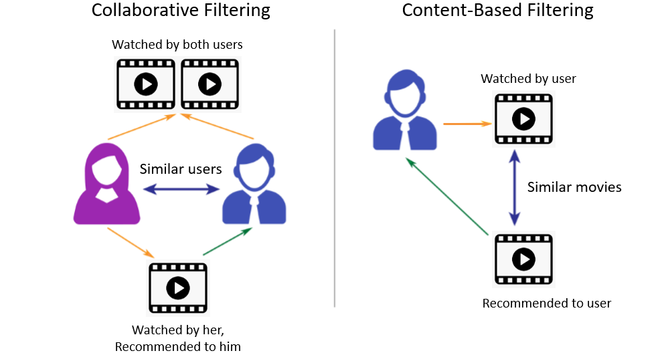
Types of Recommender System

Slide 4
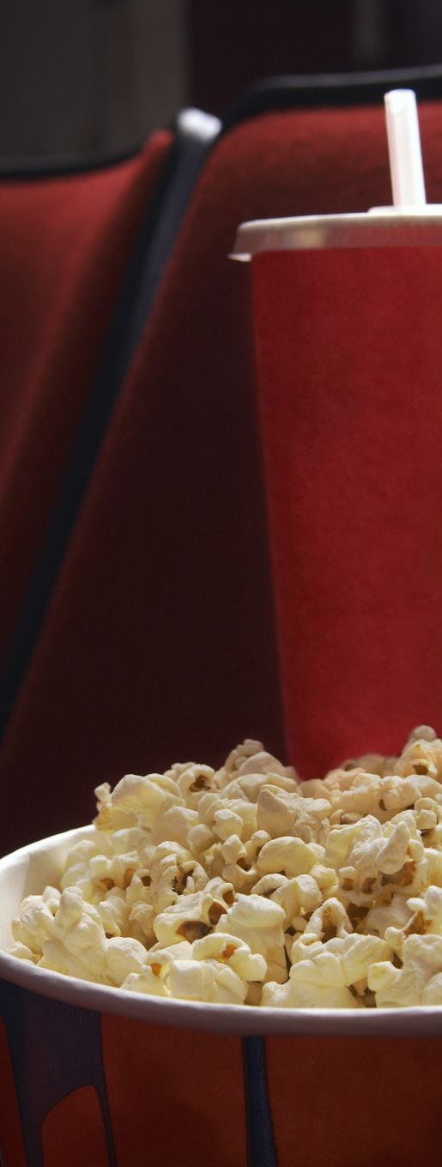
Content Based Hollywood Movie Recommender System
Working
Content Based Recommender System recommends items similar to the items user likes.
How does it decide which item is most similar to the item user likes ?
Similarity Scores

Slide 5

Similarity Score
It is a numerical value ranges between zero to one which helps to determine how much two items are similar to each other on a scale of zero to one.
This similarity score is obtained measuring the similarity between the text details of both of the items. So, similarity score is the measure of similarity between given text details of two items. This can be done by cosine-similarity.

Slide 6
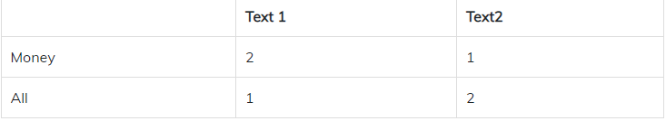
How Cosine Similarity works?
The example below showns how to get cosine similarity:
Step 1 : Count the number of unique words in both texts. Step 2 : Count the frequency of each word in each text. Step 3 : Plot it by taking each word as an axis and frequency as measure. Step 4 : Find the points of both texts and get the value of cosine distance between them.
Example : Text 1 = “Money All Money” Text 2 = “All Money All” Step 1 : There are only two unique words between both texts. ‘Money’ and ‘All’ Step 2 : Counting the frequency.

Slide 7
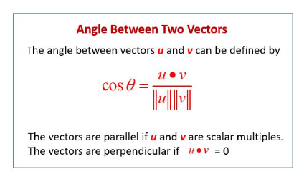
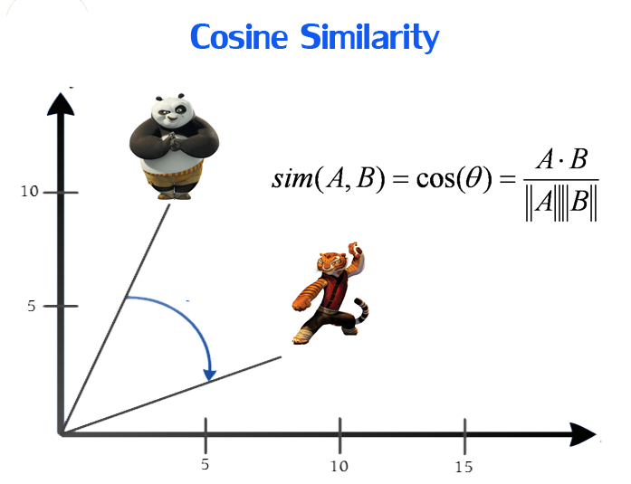
Step 3 and Step 4 : There are only two unique words, hence we’re making a 2D graph.
Now we need to find the cosine of angle ‘a’, which is the value of angle between both vectors.
Here is the formula used for doing this:
This was all the Math behind cosine similarity, which is used by Content Based Recommender System.

Slide 8
Flowchart
Gather the data
Performing EDA
Data cleaning
Feature Extraction
Model building
Training
Recommendation

Slide 9
The details of the movies i.e. ,
Title: Movie Title.
Overview: Abstract of the Movie.
Popularity: Movie popularity rating as per TMDB.
Release date: Date of release of the movie.
Genres: Movie Genres in the list.
Homepage: Websites held by the movie.
Poster: Poster of the Movie published
are fetched using an API by TMDB https://www.themoviedb.org/documentation/api

Slide 10
Sources of the Datasets
IMDB 5000 Movie Dataset - https://www.kaggle.com/datasets/carolzhangdc/imdb-5000-movie-dataset
The Movies Dataset-https://www.kaggle.com/datasets/rounakbanik/the-movies-dataset
List of movies in 2018 -https://en.wikipedia.org/wiki/List_of_American_films_of_2018
List of movies in 2019 -https://en.wikipedia.org/wiki/List_of_American_films_of_2019
List of movies in 2020 -https://en.wikipedia.org/wiki/List_of_American_films_of_2020
List of movies in 2021 https://en.wikipedia.org/wiki/List_of_American_films_of_2021 -

Slide 11

Streamlit
Streamlit is an open source app framework in Python language. It helps us create web apps for data science and machine learning in a short time. It is compatible with major Python libraries such as scikit-learn, NumPy, pandas, Matplotlib etc.
With Streamlit, no callbacks are needed since widgets are treated as variables.
Data caching simplifies and speeds up computation pipelines.

Slide 12

Conclusion
Conclusion: In conclusion, this machine learning project successfully built a recommendation system for movies that provides personalized recommendations based on the user's preferences. The use of three different datasets, calculation of similarity scores, and feature extraction using an API provided by TMDB, allowed for a comprehensive recommendation system. The deployment of the system using Streamlit makes it accessible to users and allows for an interactive experience.

